Slide 1
Performance Analysis of Tennis Players
By Abhinav Prabhu Adarapuram

Slide 2
CONTENTS
Introduction
Data Description
Supervised Machine Learning
Experiments
Obtained Results
Unsupervised Machine Learning
Experiments
Obtained Results
Future Work

Slide 3
Data Description
The dataset was obtained from awesome public datasets in Github.
This dataset consists of the information recorded from various tennis tournaments right from 1969 – 2018* (Updated till October).
The information includes the winner and the loser details such as name, age, height, rank, rank points, seed level.
It also tracks the tournament name, date, location, match results, match scores.

Slide 4
Data Description (Cont’d)
The winner’s hand is considered as the target variable in this dataset.
This dataset has 98000 observations and 50 variables out of which 15 are continuous variables.

Slide 5
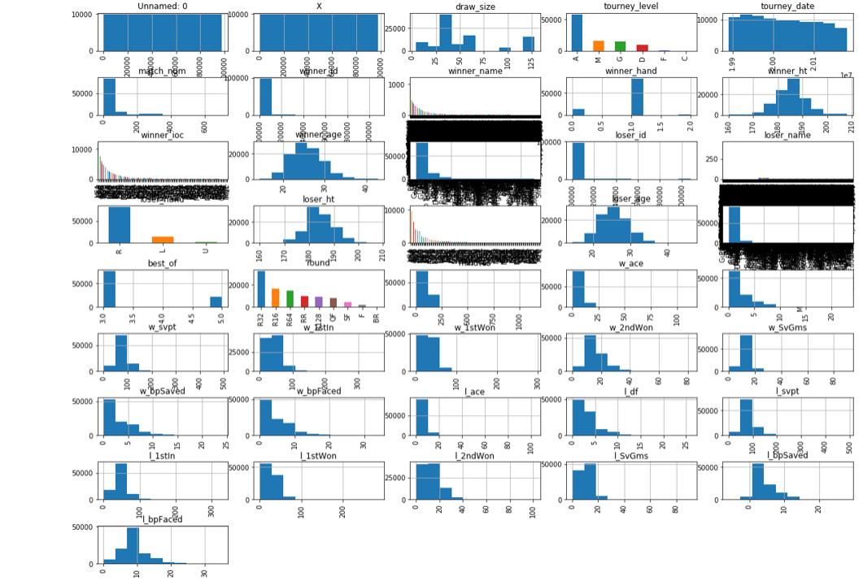
Data visualization

Slide 6
Supervised machine learning
A major part of the practical machine learning process uses the supervised learning.
Supervised learning is a technique where we have input variables (X) and an output variable (Y). We later use an algorithm to obtain the mapping function from input to output.
The main objective of this function is that when we have new input data (X), we can predict the output variable (Y) for the given data.

Slide 7
Supervised learning (Cont’d)
Supervised learning problems are divided into two groups:
            Classification
            Regression
Classification: In classification problem, the output variable is a category such as male or female, pass or fail, disease or no disease.
Regression: In regression problem, the output variable is a real value such as weight, distance.

Slide 8
Experiments
Aim: The objective for the supervised learning is to identify whether the right hand players have won more matches or the left hand players.
We make use of classification models to analyze and obtain the training and testing scores such that we can conclude which model is more accurate.

Slide 9
Models used
Logistic Regression
K nearest neighbors
Naiye Bayes
Decision Tree
Random Forest

Slide 10
Obtained results
Types of Models | Training Percentage | Testing Percentage
Linear Regression | 84.33 | 84.91
K Nearest Neighbors | 87.10 | 85.55
Decision Tree | 100.00 | 99.42
Naive Bayes | 74.63 | 74.94
Random Forest | 100.00 | 98.53
We have done a thorough analysis of Tennis ATP tournament dataset. We have targeted the winner's hand i.e. whether the winner uses left hand or right hand during the match. We ended up analyzing with 5 different methods viz. Logical regression, K-nearest neighbor, Decision tree, Naive bayes and Random forest. The training accuracy for decision tree method and random forest method is perfect 100% while for testing case we have achieved an accuracy of 99.42% using decision tree model followed by 98.53% testing accuracy using random forest method.

Slide 11
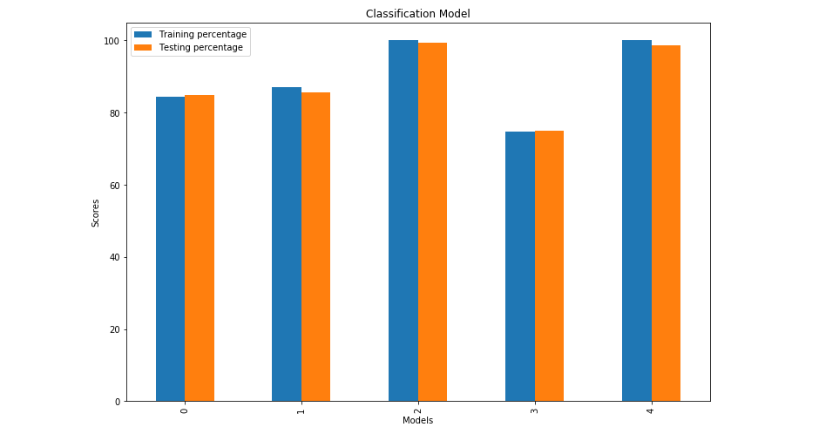
results

Slide 12
Unsupervised learning
Unsupervised learning is a technique where we have only input data (X) and no output variables.
The unsupervised learning has no correct answers.
It’s goal is to model the structure of the data such that we can learn more about the data.

Slide 13
Unsupervised learning (cont’d)
Unsupervised learning can be further grouped as:
            Clustering
            Association
Clustering: In clustering, we can discover the inherent or hidden groupings within the data such as grouping people by qualification.
Association: In association, we can discover that describes the data as well as the relation. Example: A person who did Bachelors may also tend to enroll in Masters program.

Slide 14
experiments
Aim: The objective in unsupervised learning is to analyze the performance of over 100 different countries which have participated from 1989 – 2018 using various clustering techniques.
To obtain the results, we use clustering techniques such as hierarchical clustering, model based clustering, k means clustering, etc.

Slide 15
Obtained results
In this process, I have divided the dataset into 3 decades ( 1989 – 1998), (1999 – 2008) and (2009 – 2018).
While working on the dataset after preprocessing, I tried to fit the dataset in few clustering algorithms and have obtained the following outcomes.

Slide 16
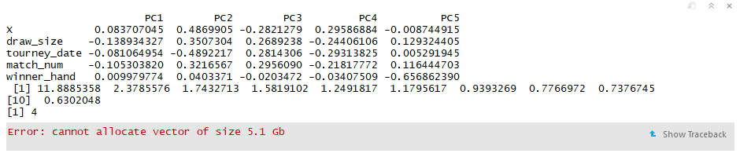
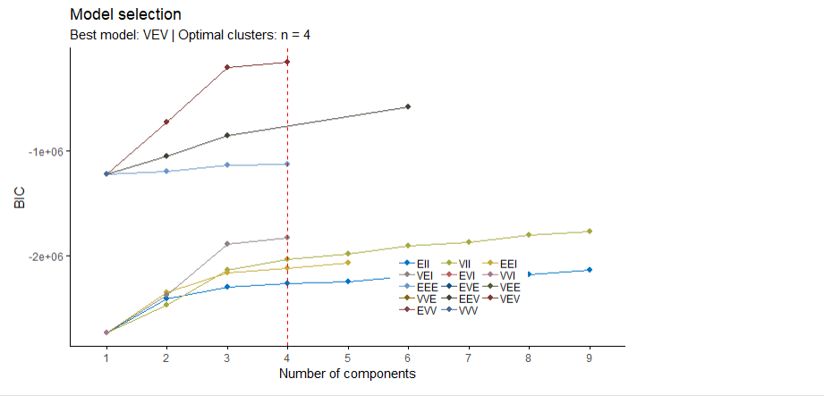
Decade 1

Slide 17
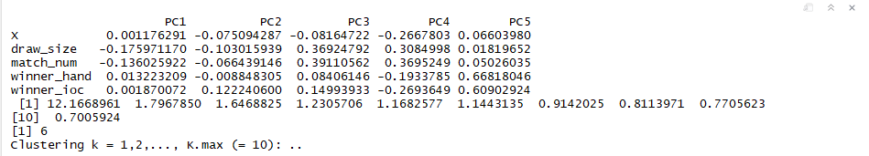
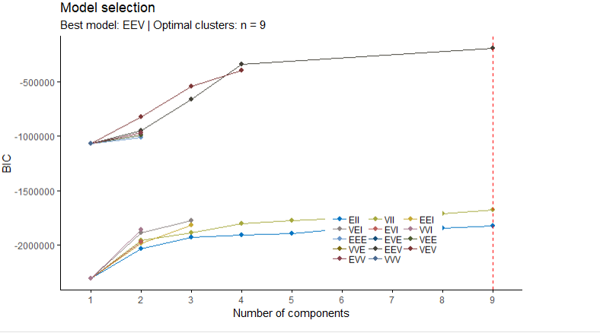
Decade 2

Slide 18
Future work
In clustering part, due to high volume of the data, I am unable to obtain proper results for h-clust, k means clustering and nb-clust. To get the desired outcome, I am planning to resize the dataset to avoid memory allocation problem.
I am working on the association part.

Slide 19
Thank you

